Slide 1


Slide 2

The Clapper
Workshop 2 - Programming

Slide 3
This Week – Setup
Information on this week’s workshop can be found on Github https://github.com/CPlant1/EESS-Clap-Activated-Light
We will be programming the ATTiny85 Development Board
Arduino IDE Installation
Drivers
Board file

Slide 4

Arduino IDE & Driver Installation
Visit https://www.arduino.cc/en/software to download the latest software if you don’t already have IDE installed.
Open up the program and in.. File > Preferences > Additional Boards Manager, paste in the following URL: https://raw.githubusercontent.com/ArminJo/DigistumpArduino/master/package_digistump_index.json This will install the Digistump AVR Board.
Any problems? Feel free to ask for help, we might have to download a legacy version of Arduino.

Slide 5

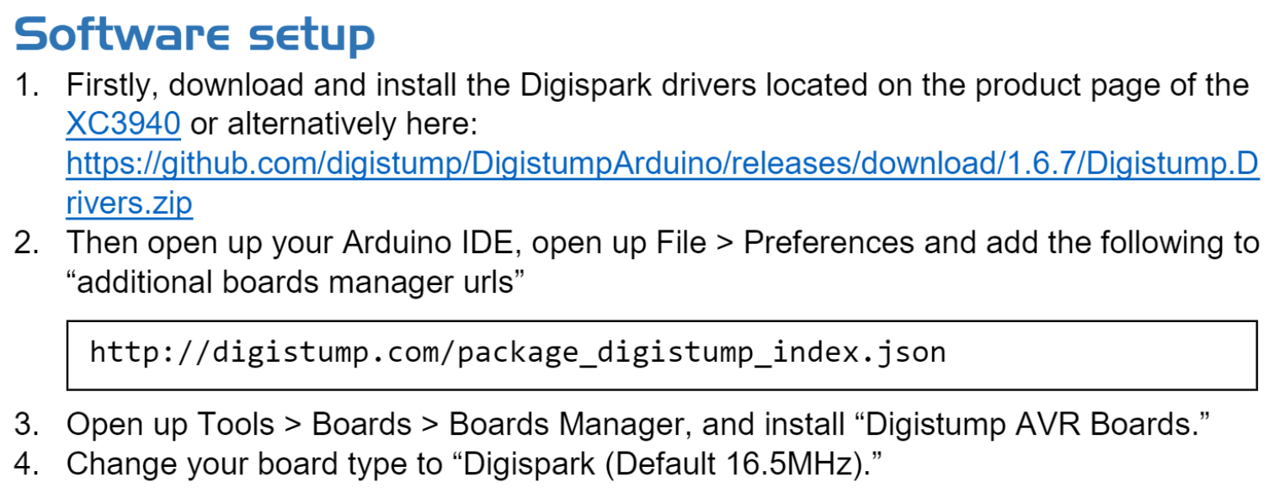
Driver Installation

Slide 6
Code
File found in GitHub, look for: Clapper_ArduinoIDE_Base.ino
Quick step through code
Programming method via USB
Program it!

Slide 7
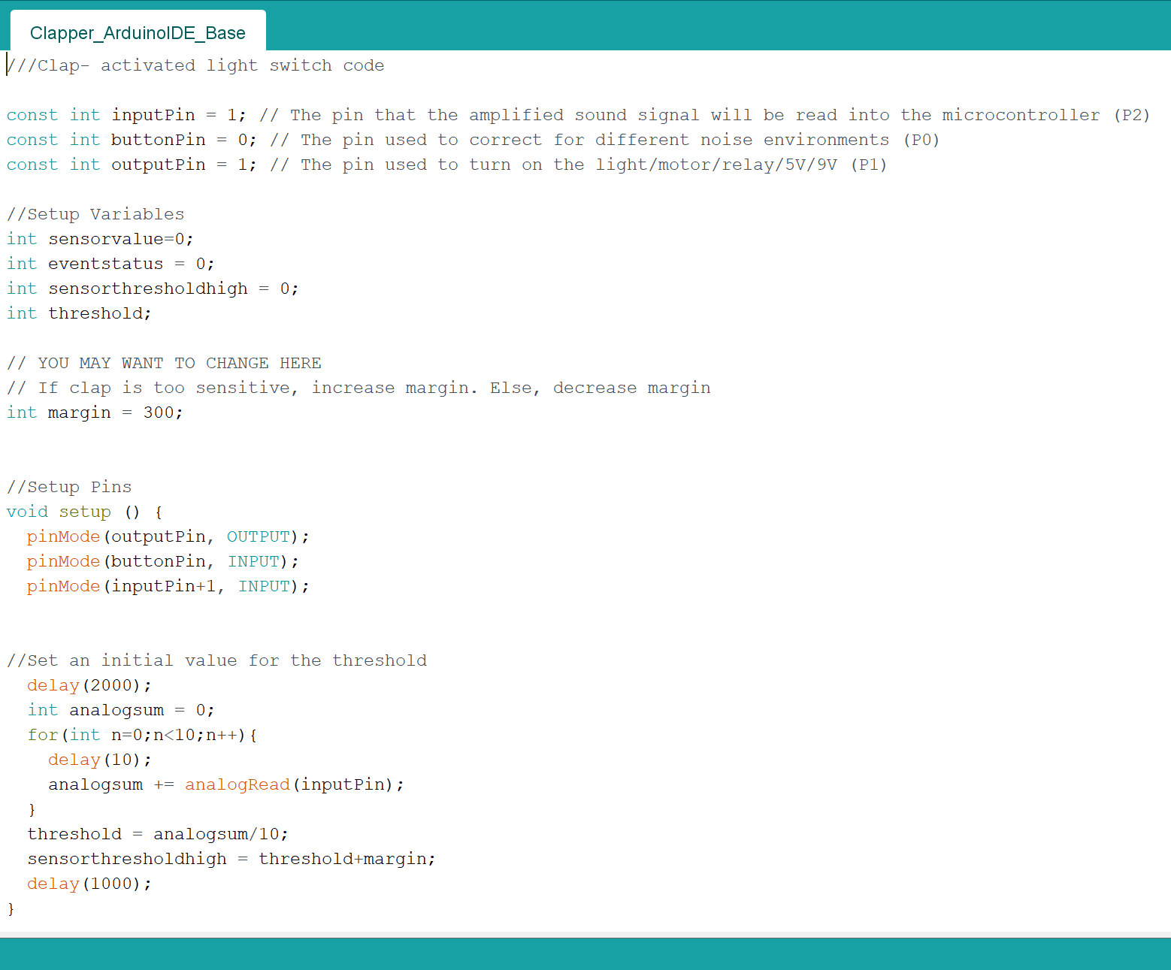
The Code

Slide 8
Hardware
Incorporate environment noise threshold button into circuit
LED light as output test
Solder legs onto ATTiny85 board for breadboard connection

Slide 9
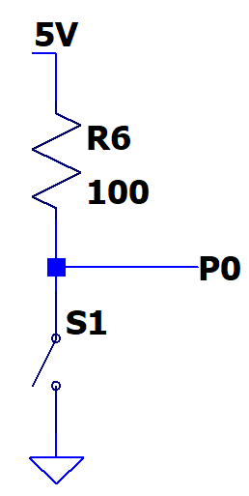
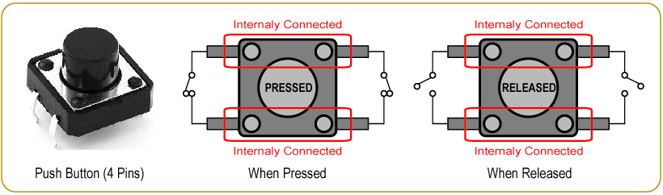
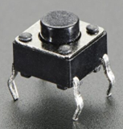
Button
Switch Closes Switch Opens when pressed when released

Slide 10

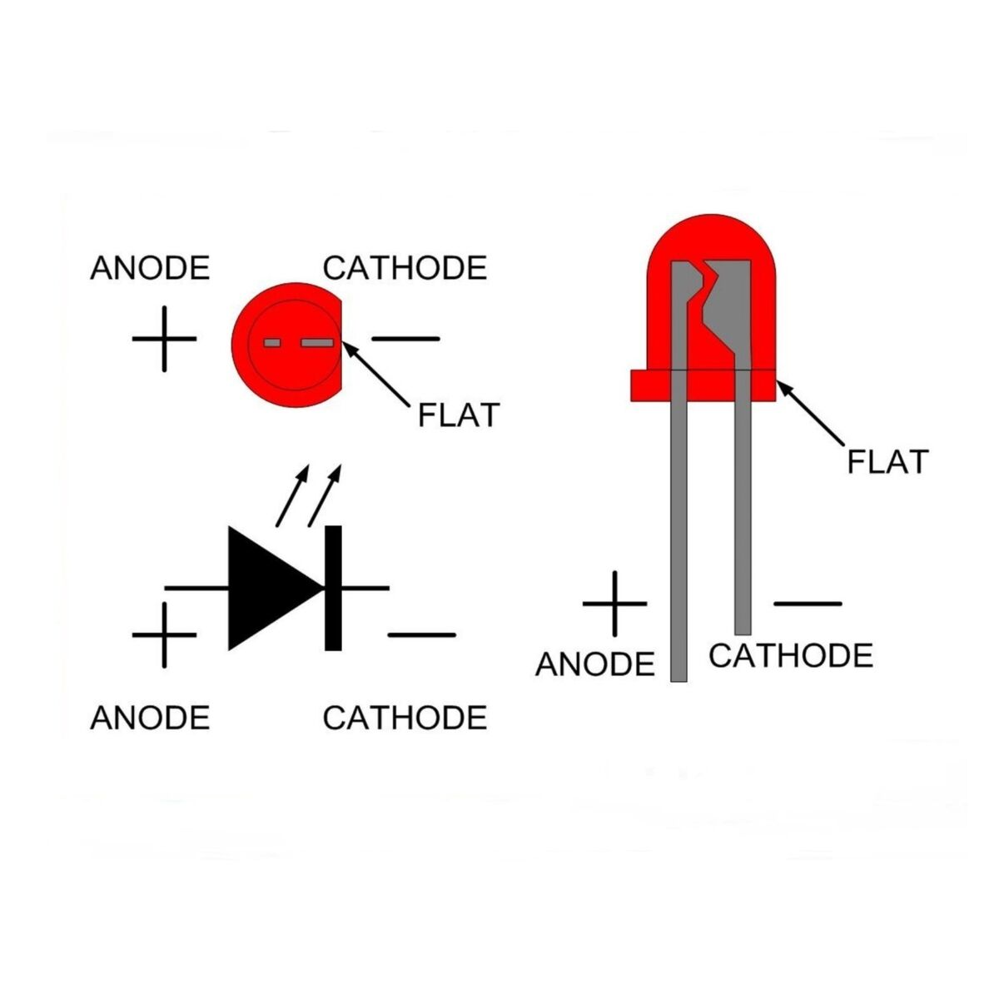

Lights

